Slide 1

Real-time Emotion Detection
By:
Hira Tahir (20K-0374)
Naima Jamal (20K-0404)

Slide 2
Introduction:
Facial emotion detection using machine learning is a rapidly growing field of research that has numerous applications in the fields of psychology, marketing, and artificial intelligence. This technology uses algorithms to detect emotions from facial expressions by analyzing images of a person's face. By detecting and recognizing emotions, machines can be programmed to respond accordingly, providing more personalized and human-like interactions.

Slide 3
Dataset:
The dataset used for training and testing the machine learning model for facial emotion detection is called the "Challenges in Representation Learning: Facial Expression Recognition Challenge" dataset, which is available on Kaggle.
This dataset contains 35,887 grayscale images of faces, each of size 48x48 pixels. The images are categorized into seven different emotions, including anger, disgust, fear, happiness, sadness, surprise, and neutral. There are approximately equal numbers of images for each emotion in the dataset.
In addition to the images, the dataset also includes two files, "fer2013.csv" and "example_submission.csv," which provide additional information about the dataset and are useful for preparing the data for training and testing the machine learning model.

Slide 4
Preprocessing:
The preprocessing is done using ‘ImageDataGenerator’ class from Keras. The ‘train_datagen’ is used to create a generator that rescales the pixel values of the images to be between 0 and 1 using ‘rescale’ parameter.
‘Rotation_range’ rotates the images, ‘width_shift_range’ and ‘height_shift_range’ shifts the images horizontally and vertically and ‘horizontal_flip’ flips the images horizontally.

Slide 5
Machine Learning Algorithm:
The code is for a deep learning model that uses the MobileNet architecture for image classification.

Slide 6
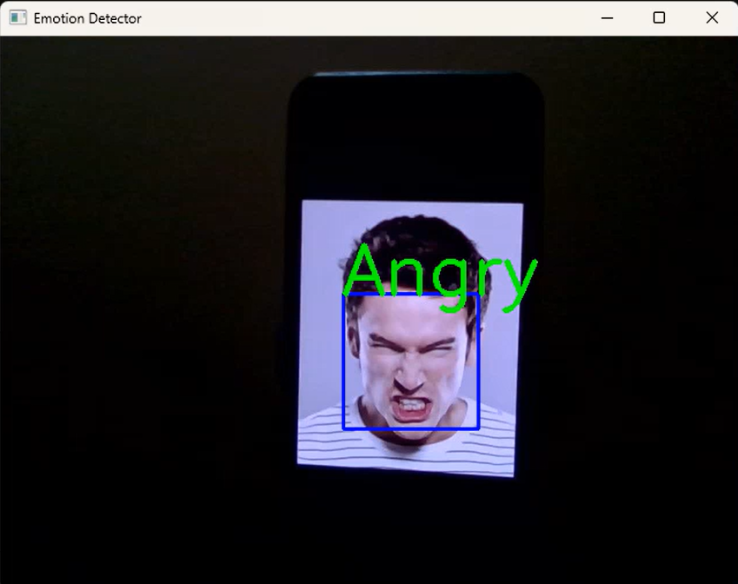
Results:

Slide 7
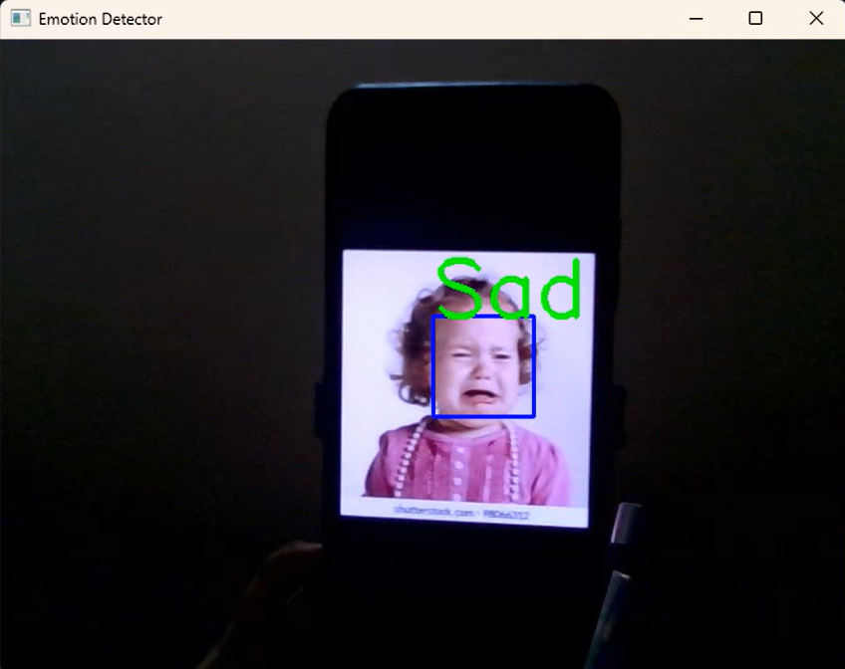
Results:

Slide 8
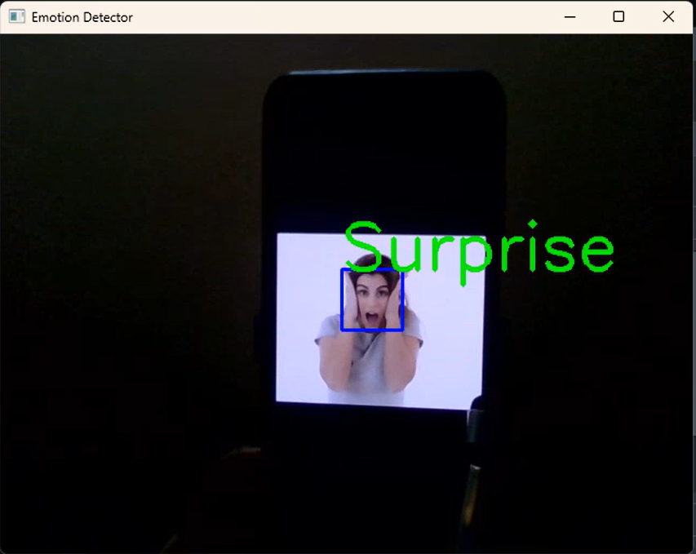
Results:

Slide 9
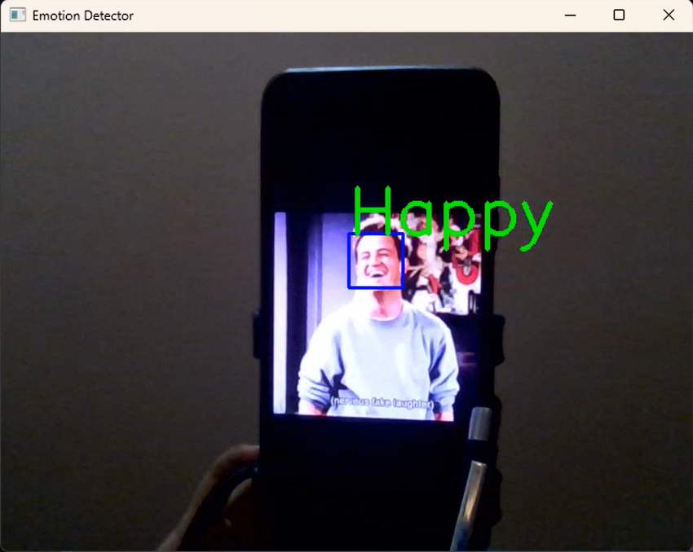
Results:

Slide 10
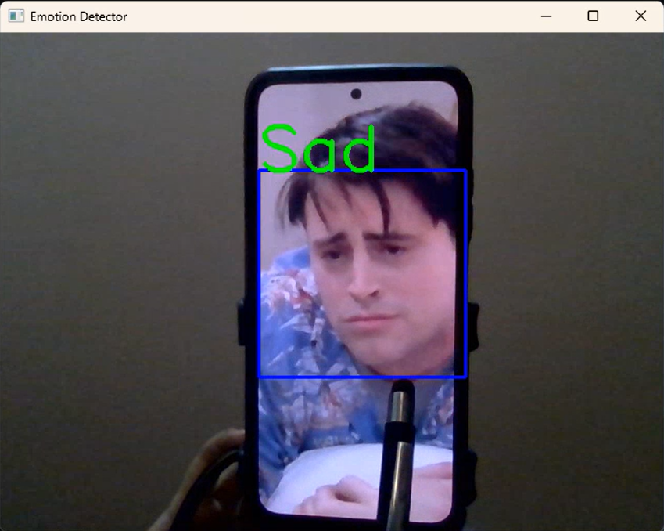
Results:

Slide 11
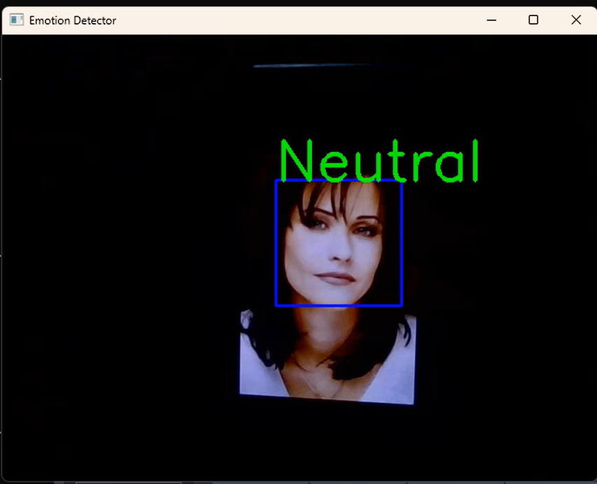
Results:

Slide 12
References:
https://www.kaggle.com/c/challenges-in-representation-learning-facial-expression-recognition-challenge/data

